Slide 1
Python Fundamentals Unlocking the Power of Python
Introduction

Slide 2
Table of contents
01
02
03
04
Who Can Learn Python?
Why Learn Python?
Benefits of Learning Python
Python Domains

Slide 3
01
Who Can Learn Python?

Slide 4
Who Can Learn Python?
Beginners with no programming experience
Students, professionals, and enthusiasts in any field
Anyone interested in automation, data analysis, web development, or artificial intelligence

Slide 5
02
Why Learn Python?

Slide 6
Why you should consider it?
Versatility: Used in various domains such as web development, data science, artificial intelligence, and more
Easy to Learn: Simple syntax and readability make it beginner-friendly
Community Support: Vast community resources and libraries for support and collaboration
Career Opportunities: High demand for Python developers across industries

Slide 7

Benefits of Learning Python

Slide 8
Faster Development
Scalability
Rapid prototyping and development due to its concise syntax
Suitable for small scripts to large-scale applications
Interoperability
Cost-Effective
Easily integrates with other languages and tools
Open-source nature reduces software development costs

Slide 9
04
Python Domains

Slide 10
Domains
Python in Hacking
Powerful scripting capabilities make it popular in ethical hacking and penetration testing
Libraries like Scapy for packet manipulation and Metasploit for vulnerability exploitation
Used for automating tasks in security analysis and tool development
Python in Data Mining
Extensive libraries like Pandas, NumPy, and Scikit-learn for data manipulation and analysis
Web scraping tools like Beautiful Soup and Scrapy for extracting data from websites
Used in gathering insights from large datasets for business intelligence and decision-making

Slide 11
Domains
Python in Artificial Intelligence
Libraries like TensorFlow and PyTorch for building and training neural networks
Natural Language Processing (NLP) libraries like NLTK and spaCy for text analysis
Used in developing intelligent systems for automation, recommendation systems, and predictive analytics
Python in Web Development
Frameworks like Django and Flask for building dynamic and scalable web applications
Libraries like BeautifulSoup and Selenium for web scraping and automation
Widely used in backend development, APIs, and server-side scripting

Slide 12
What is Python and History of Python?
05

Slide 13
Brief History of Python
Invented in the Netherlands, early 90s by Guido van Rossum
Named after Monty Python
Open sourced from the beginning
Considered a scripting language, but is much more
Scalable, object oriented and functional from the beginning
Used by Google from the beginning
Increasingly popular

Slide 14
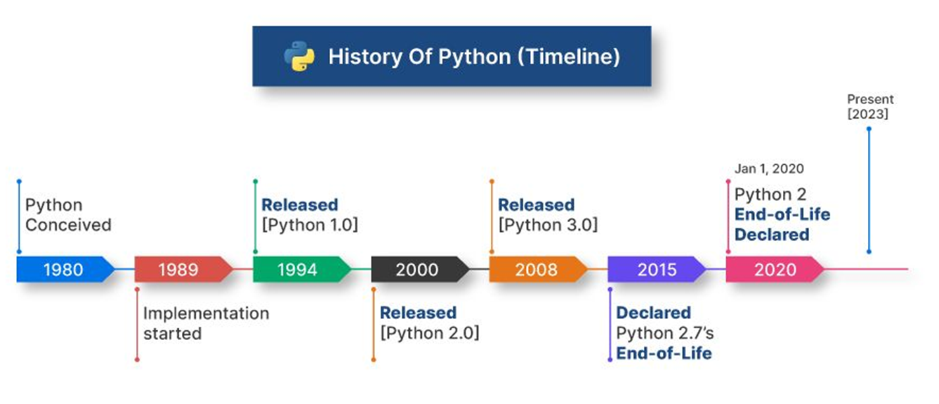

Slide 15
“Python is an experiment in how much freedom programmers need. Too much freedom and nobody can read another's code; too little and expressive-ness is endangered.”
- Guido van Rossum

Slide 16
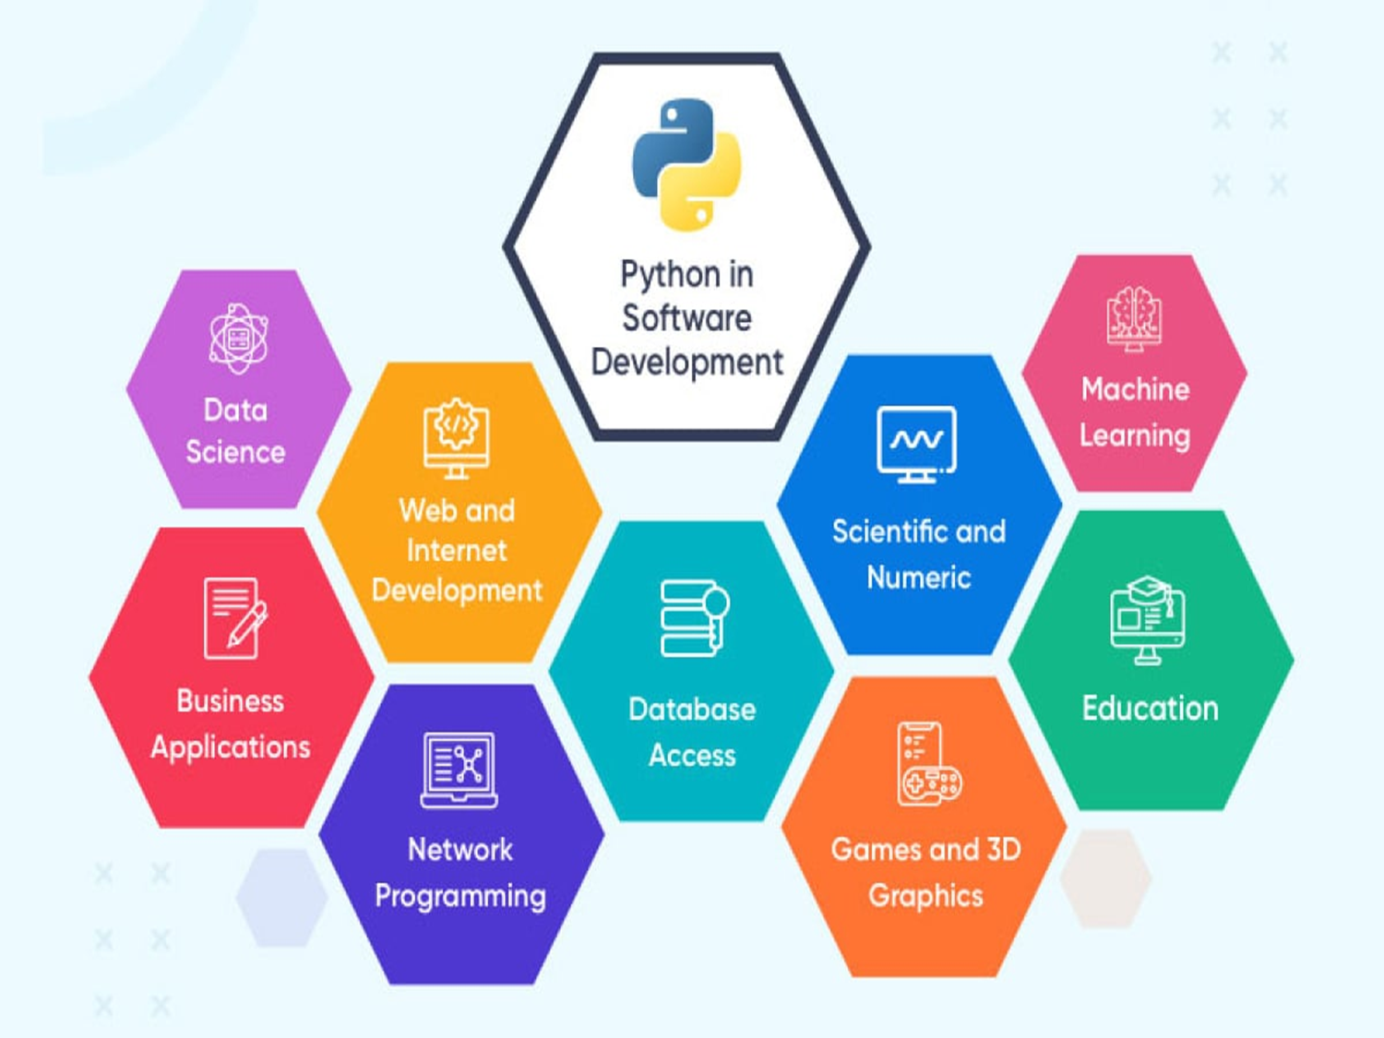

Slide 17
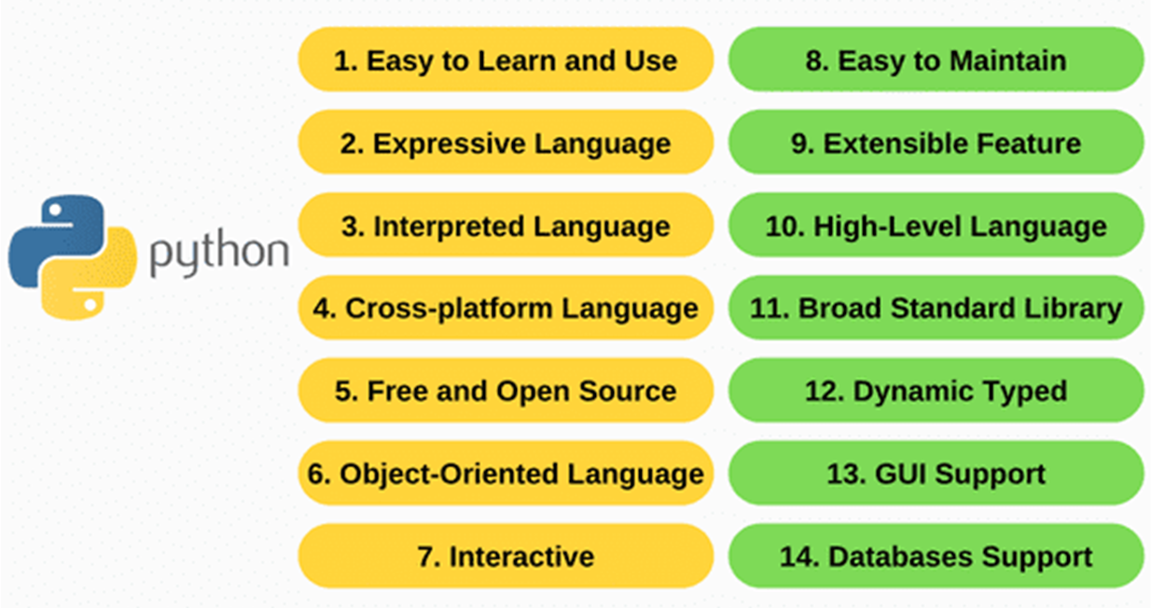
Identify and Describe Unique Featues of Python

Slide 18
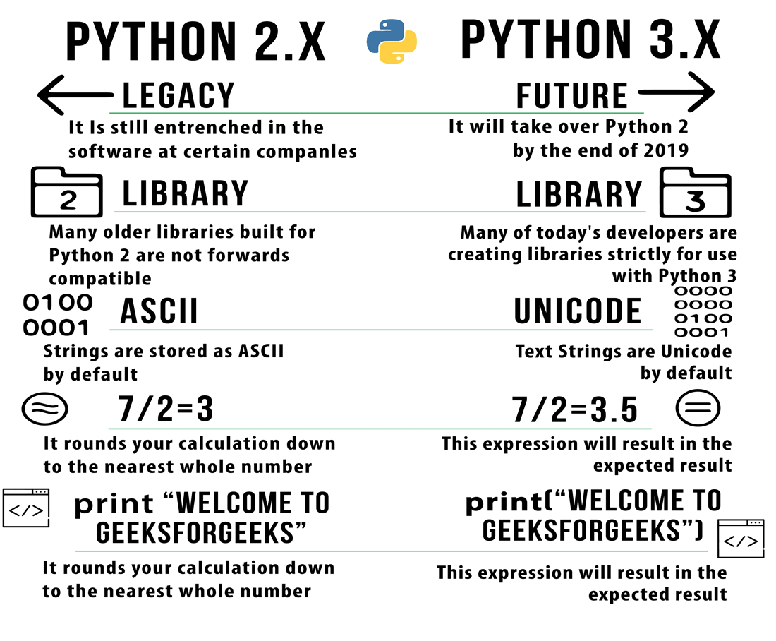
Python 2 vs Python 3

Slide 19
06
Install Python and Environment

Slide 20
Python IDE’s
Python is pre-installed on most Unix systems, including Linux and MAC OS X
Download from http://python.org/download/
Python comes with a large library of standard modules
There are several options for an IDE
IDLE – works well with Windows
Emacs with python-mode or your favorite text editor
Eclipse with Pydev
Shell
Jupyter notebook (nice to try)
PyCharm

Slide 21
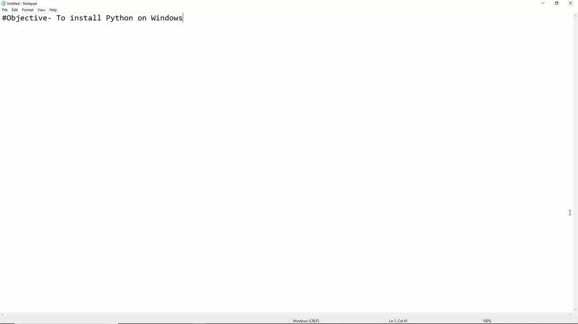

Slide 22
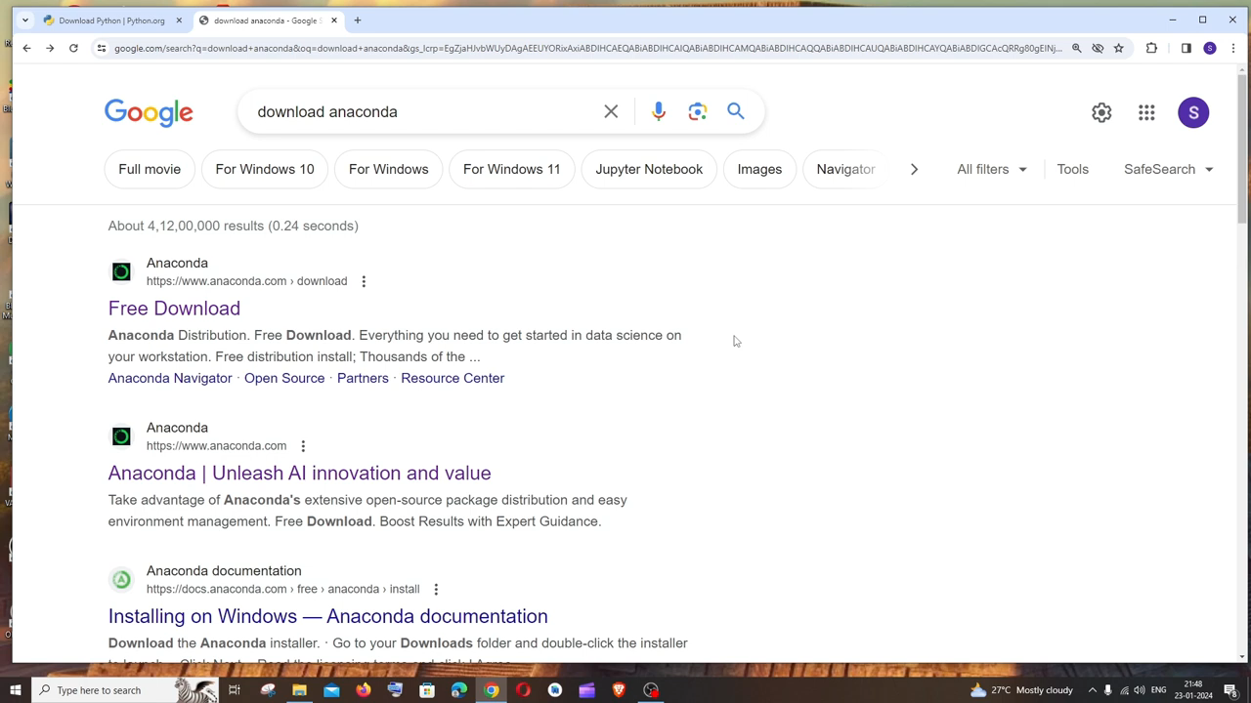

Slide 23
07
Python First Program

Slide 24
A Code Sample (in IDLE)
x = 34 – 23 = 11 # A comment.
y = “Hello” # Another one.
z = 3.45
if z == 3.45 or y == “Hello”:
x = x + 1 = 12
y = y + “ World” # String concat.
print (x)
print (y)

Slide 25
08
Python Identifiers, Keywords and Indentation

Slide 26
Identifier vs Keywords in Python
Keyword
Identifier
Keywords in Python are predefined words that have a special meaning to the interpreter. They are reserved words that are used to perform a specific task in Python programming.
Identifiers in Python are names given to different parts of a Python program like variables, functions, classes, etc.

Slide 27
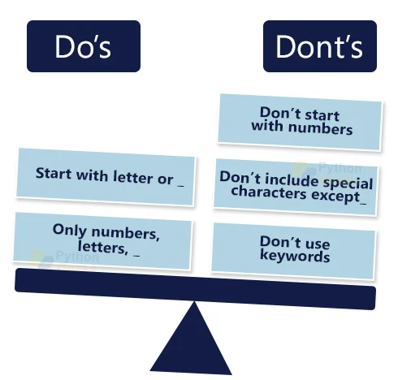
Naming Variables

Slide 28
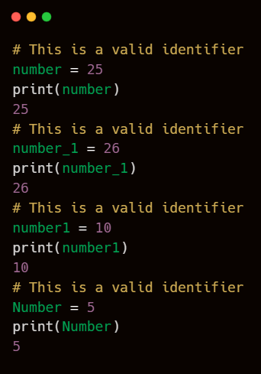
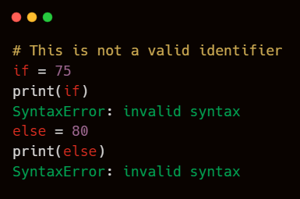
Variables Identifiers

Slide 29
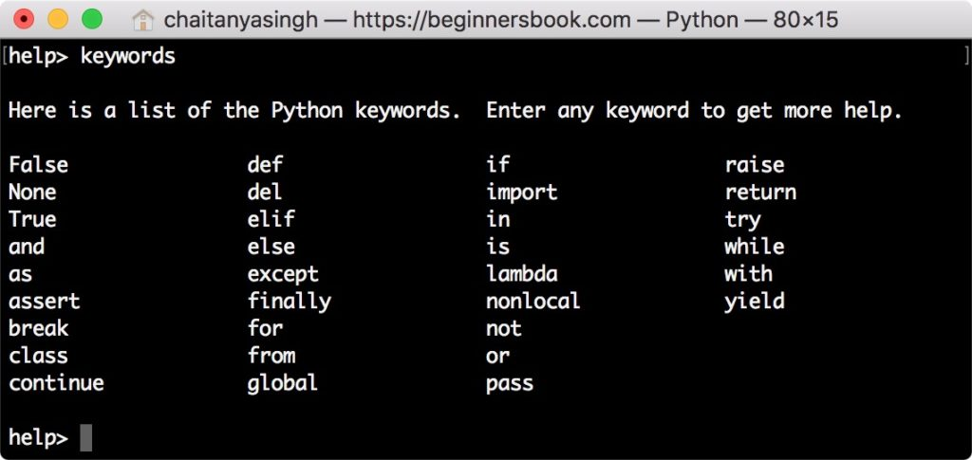
Keywords list

Slide 30
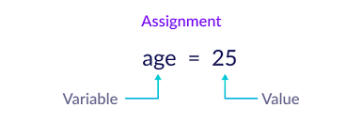
Declaration and Assignment

Slide 31
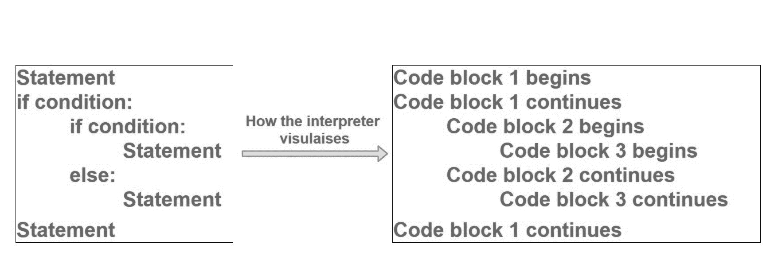
Indentation in Python

Slide 32
09
Comments and document interlude in Python

Slide 33
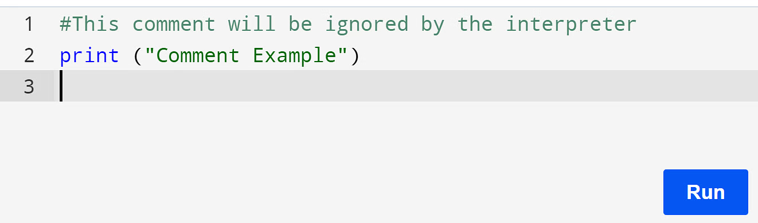
Comments in Python
Comments in Python is the inclusion of short descriptions along with the code to increase its readability.
A developer uses them to write his or her thought process while writing the code.
There are multiple uses of writing comments in Python. Some significant uses include:
Increasing readability
Explaining the code to others
Understanding the code easily after a long-term
Including resources
Re-using the existing code

Slide 34
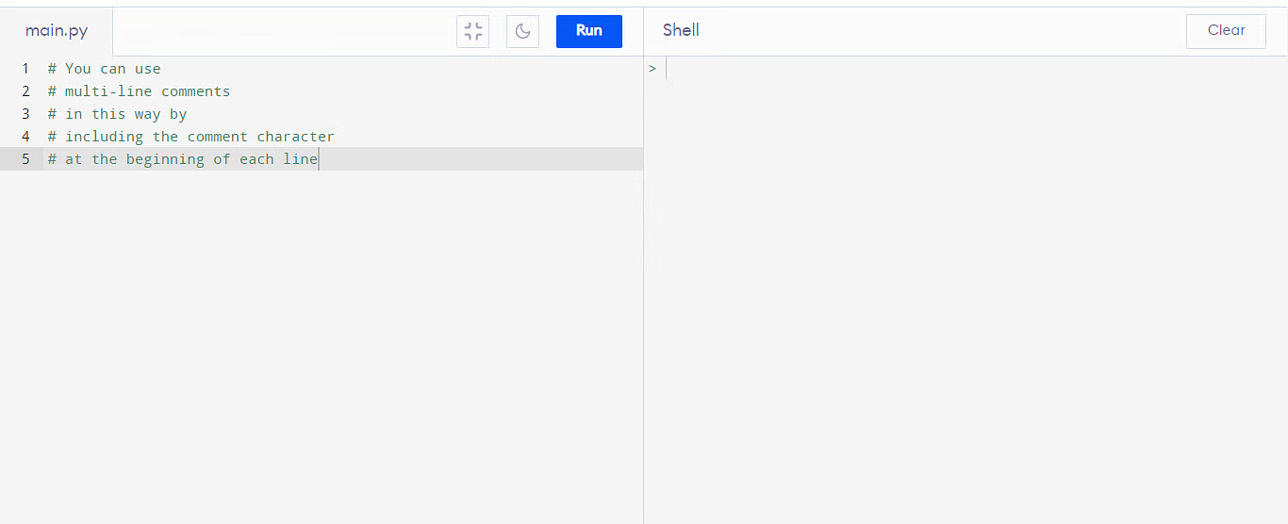
Multi-Line Comments

Slide 35
Document interlude in Python
A document interlude in Python, conceptually, refers to a distinct section within a document generated by Python code that serves as a break or a shift in the content flow.
In practical terms, creating a document interlude using Python involves:
Purpose: The interlude's purpose is to provide a pause in the primary narrative, offering the reader extra information or a moment of reflection without disrupting the main flow.
Formatting: The interlude is often formatted distinctly to differentiate it from the main content. This can be achieved through:
Headings: Using a different heading style or level to mark the beginning of the interlude.
Styling: Applying unique text styles such as italics, bold, or different font sizes.
Visual Elements: Including visual elements like horizontal lines, borders, or background shading to set it apart.
Libraries: To implement interludes in documents, Python libraries such as `python-docx` for Word documents or `reportlab` for PDFs are typically used. These libraries provide functionalities to add and style text, create headings, and incorporate other visual elements.
Content: The content of an interlude can vary widely but usually includes:
Explanations: Clarifications or detailed explanations of complex topics mentioned in the main text.
Notes: Additional notes or asides that provide extra context or interesting facts.
Quotes: Relevant quotes that complement the main content.

Slide 36
10
Python Command Line Arguments

Slide 37
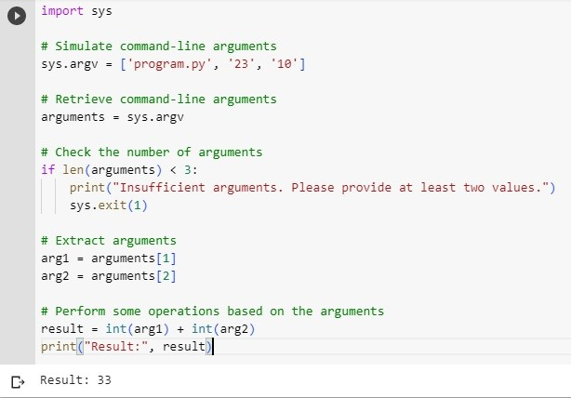
Python Command Line Arguments
This provides a convenient way to accept some information at the command line while running the program.
We usually pass these values along with the name of the Python script.
To run a Python program, we execute the following command in the command prompt terminal of the operating system.

Slide 38

Python DataTypes

Slide 39
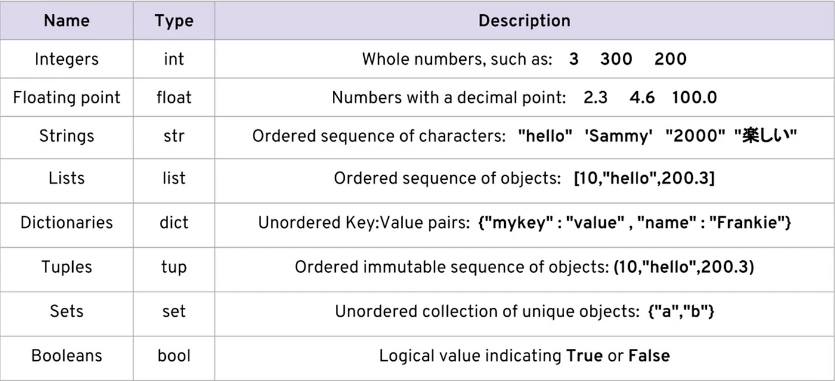
Python DataTypes

Slide 40
12
Python Variable

Slide 41
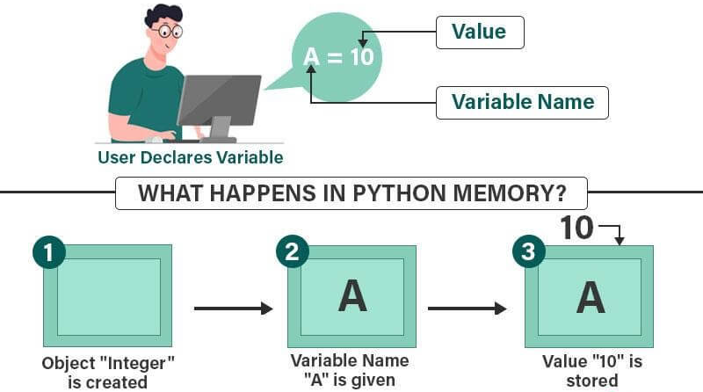
How variable works

Slide 42
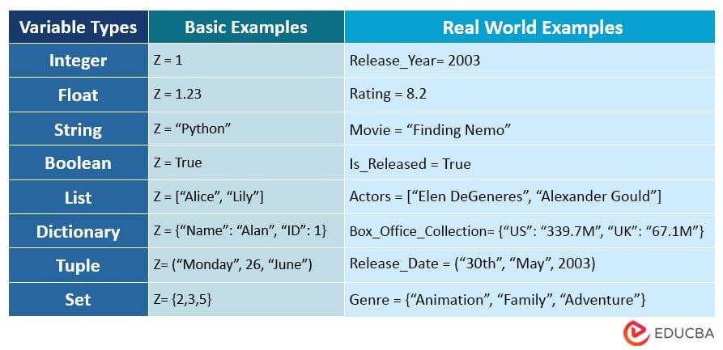

Slide 43
Python Core objects and Functions
13

Slide 44
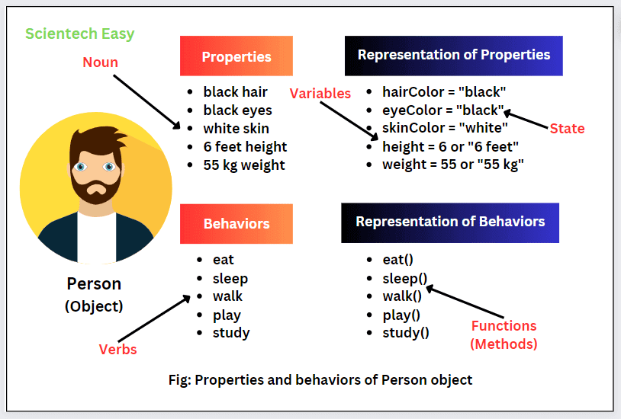
Object vs Function
Object
An object is a collection of functions and data.
Function
A function is a collection of commands and data.

